Slide 1
XCode and Storyboard
Vraj Suratwala

Slide 2
Topics Covered
Introduction to XCode and Storyboard
Advantages and Disadvantages Storyboard
Interface builder and an Outlets
Introduction UIView, UIController and UIWindow
Windows and Views
MVC Pattern in UI

Slide 3
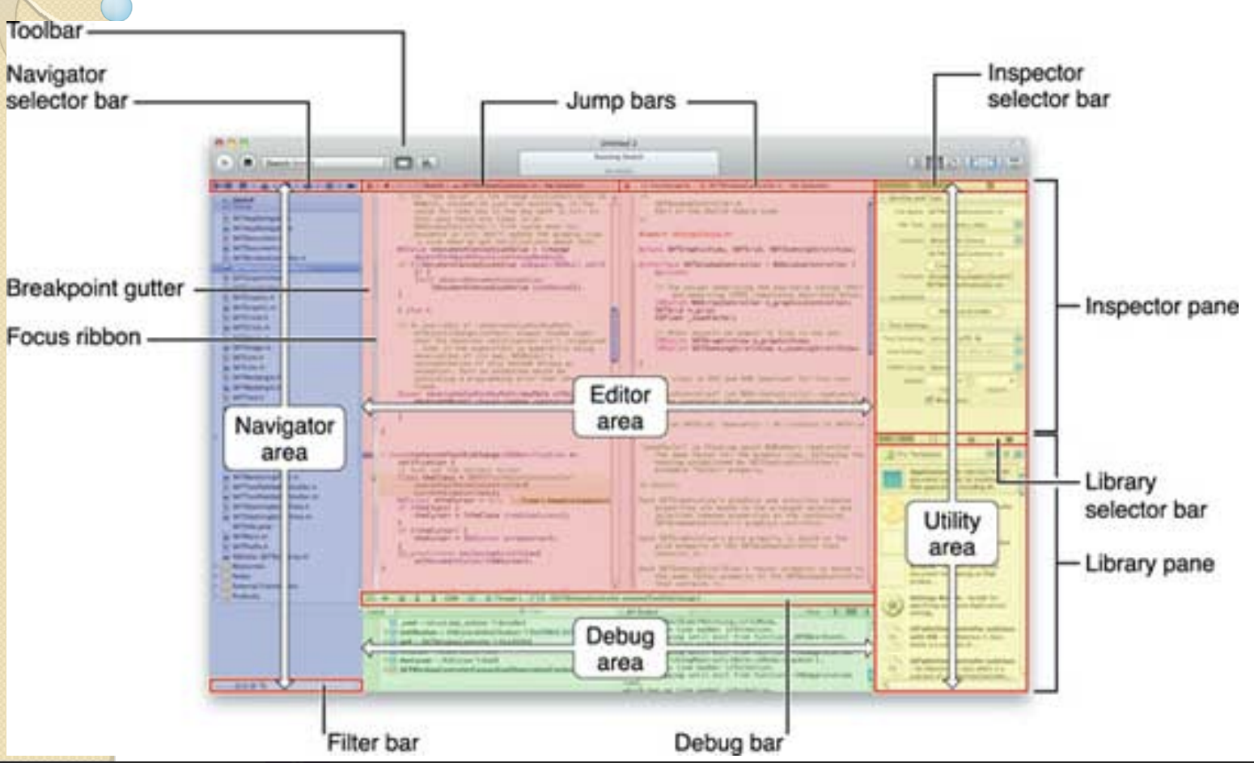
XCode Diagram - For Understanding

Slide 4
Introduction to Storyboard
a storyboard is a visual representation of the user interface of an IOS application , showing screens of content and the connections between those screens.
a storyboard is a Sequence of scenes, each of which represents a view controller and its views.
scenes are connected by segue objects which represnts translation between two view controller.
all is working under an interface called “MainStoryboard.storyboard”

Slide 5
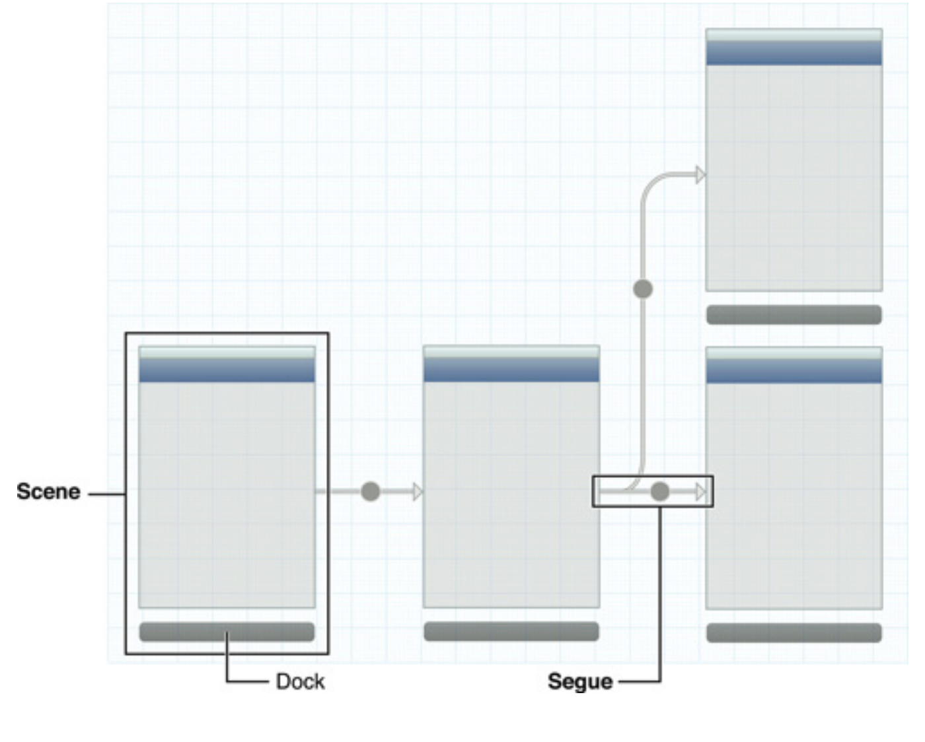
Visualization of Scene and Segua

Slide 6
Advantages and Disadvantages of Storyboard
Advantages :
  better concaptual overiview of screens and connection between them.
  describe transition between screens.
  easy to work with table and new prototype and static cel feature.
  also provides .xlibs if needed.
Disadvantages :
  Need a big Moniter.
  Obly Available in ios 5 and onwards.
  Merges can be very difficult.

Slide 7
Interface Builder
it is a tool that provides functionlity to eacy creation of UI Interface.
without writing any code the Interface builder provides simple way to create UI elements.
also Provides drag and drop features to any controller along with giving option the any Apple’s Device Canvas.
Becaue of Cocoa and Cocoa Touch Frameworks , it is easy to Create UI with MVC Pattern which is separating the implementation and UI Creation.
it is creating dynamic connection between UI and codd when app is running.
saved in . nlb extension. or .xib (because of cocoa and cocoa touch frameworks).

Slide 8
Usage of Interface Builder
Design screens visually
Add UI Components
  like button, textfeild, Images, Tables
Set auto layout constraints
Connect Swift UI elements with code using IBOutlets and IBActions.
Preview UI on different screen size and devices.
  Example : IPhone , IPad

Slide 9
Working Interface Builder
1. Selecting and Dragging the Control from Object Library
2. Place them on View Controller
3. Setting all Attributes.
  like text, color, size, font
4. Adding constraint for respactive layouts
5. Conect UI elements to swift code.

Slide 10
Outlet
an outlet is a property of an object that references another object, the reference is archived through interface builder.
the connections between the containing object and it’s outlets are reestablished every time the containing object is unarchived from its nib file.
the containing object holds an outlet declared as a property with the type qualifier of IBOutlet.
It is more then simple property.

Slide 11
Syntax : IBOutlet and IBAction
syntax : @IBOutlet weak var nameLabel : UILabel!
note : here weak is one the swift keyword which is used to avoid memory leaks.
syntax : @IBAction func buttonTapped(_sender : UIButton){
  // code should goes here
  }
_sender is the passes the reference of the control which send the action to fucntion and performs specific operation.

Slide 12
Introduction UIView, UIController, UIWindow
they are the core component of UIKit Framework, each serving it’s own functionlity for User Interface and managing it’s working / process flow.
UIView :
  basic building block for visual element of screen.
  it is rectangular area that handles drawing content, layout, and user touch interactions.
    for an example UIButton, UILabel, UImageView.(all are the subclasses of UIView)
  all views are working in hierachical manner where one view is acting as a base view(superview) for another(subview).

Slide 13
Introduction UIView, UIController, UIWindow
UIWindow :
A specialized subclass of UIView that provides the backdrop for an app's user interface.
It acts as the primary container for all of the application's views and is responsible for dispatching events (like touches) to the appropriate views.
A typical iOS app has one main UIWindow, which is created when the app launches and made visible using the makeKeyAndVisible() method.

Slide 14
Introduction UIView, UIController, UIWindow
UIViewController : An object that manages a single screen or a portion of he user interface.
It acts as the coordinator between the app's data (Model) and its visual representation (View) in the Model-View-Controller (MVC) design pattern.
A UIViewController is not a view itself but has a view property (which is a UIView) that becomes part of the UIWindow's view hierarchy.
It handles the logic, state management, and transitions between different screens, as well as responding to lifecycle events like viewDidLoad and viewWillAppear.

Slide 15
Introduction UIView, UIController, UIWindow
they are the core component of UIKit Framework, each serving it’s own functionlity for User Interface and managing it’s working / process flow.
UIView :
  basic building block for visual element of screen.
  it is rectangular area that handles drawing content, layout, and user touch interactions.
    for an example UIButton, UILabel, UImageView.(all are the subclasses of UIView)
  all views are working in hierachical manner where one view is acting as a base view(superview) for another(subview).

Slide 16
Introduction UIView, UIController, UIWindow
UIWindow :
A specialized subclass of UIView that provides the backdrop for an app's user interface.
It acts as the primary container for all of the application's views and is responsible for dispatching events (like touches) to the appropriate views.
A typical iOS app has one main UIWindow, which is created when the app launches and made visible using the makeKeyAndVisible() method.

Slide 17
Introduction UIView, UIController, UIWindow
UIViewController : An object that manages a single screen or a portion of he user interface.
It acts as the coordinator between the app's data (Model) and its visual representation (View) in the Model-View-Controller (MVC) design pattern.
A UIViewController is not a view itself but has a view property (which is a UIView) that becomes part of the UIWindow's view hierarchy.
It handles the logic, state management, and transitions between different screens, as well as responding to lifecycle events like viewDidLoad and viewWillAppear.

Slide 18
Windows and Views
Assume the screen of IPhone, so let’s understand the concept of window and Views
window : whole screen container
views : everything you see inside it.

Slide 19
What is Window ?
main container for our entire app UI.
basically do not haave any visible content themselves but provide a basic container for application’s view.
Every application has at least one window and one view per window for presenting it’s content.
points to be remember :
covers full screen
holds root view controller
displays everything

Slide 20
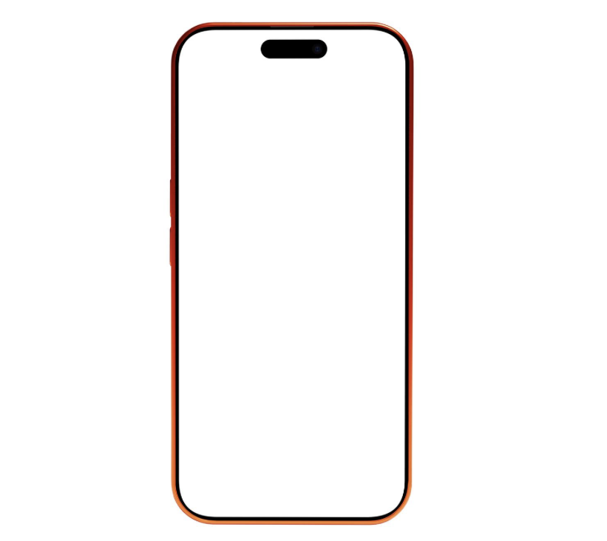
Window : IPhone Visualization
Window which must contains one View or Empty View.
It can be having multiple view as well

Slide 21
Example : Creating a Window
var window: UIWindow?
window = UIWindow(frame: UIScreen.main.bounds)
window?.rootViewController = ViewController()
window?.makeKeyAndVisible()

Slide 22
Working/ Process of Window
create window
attach root VC
show it
Run → app visible

Slide 23
Views (UIView)
refers to any visible UI Element.
Example :
  button
  textbox
  image
  custom view
  let button = UIButton()
  view.addSubview(button)

Slide 24
Views (UIView)
Basically all the basic UI Element is provided by UIKit library.
Views Manage Application’s Visual Content :
  a view is an instance of the UIView class and manages a rectangular area in application window.
  Views are responsible for :
    Drawing content
    handling multitouch events
    managing the layout of any subviews

Slide 25
View Work Flow
Window
↓
Root View
↓
StackView
↓
Button / Label / Image

Slide 26
Analogy to understand the View flow - ChatGPT
Real life | iOS
Land | Window
Rooms | Views
Furniture | Subviews

Slide 27
Adding and Removing Subviews
Interface Builder is the most convenient way to build view hierarchies.
it can assemble your views graphically, create the relationships between the views, and see exactly how those views will appear at runtime.

Slide 28
MVC Pattern in UI
MVC refers to Model, View and Controller respectivly.
Let’s Understand it with an Analogy
  M = Model == Data
  V = View == UI
  C = Controller == Logic/Brain
we will understand each one by one!

Slide 29
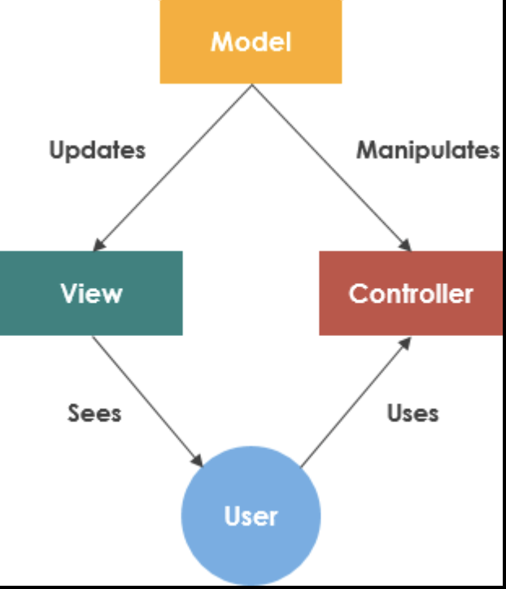
MVC working Diagram

Slide 30
1. Model in Swift
Basically, model is storing data or basinuess logic on which actually the application will performs an operations.
user interface stuff should not go here.
Examples :
  API Definition
  Database / CoreData / SQLite models
  Repos and interfaces

Slide 31
2. View
View refers UI Component.
Example :
  Button
  Textfeild
  ImageView
  Label

Slide 32
3. Controller - The Brain
connects Model + View
handles user actions
updates UI
updates data

Slide 33
Example : Controller
class ViewController: UIViewController {
var user = User(name: "Suratwala", age: 21)
@IBOutlet weak var nameLabel: UILabel!
override func viewDidLoad() {
super.viewDidLoad()
nameLabel.text = user.name
}
}

Slide 34
Overall MVC Flow
User taps button
↓
Controller handles action
↓
Model updates data
↓
Controller refreshes View
↓
UI updates

